Slide 1
Introduction to computer vision
A WORKSHOP by Maarten Knaepen

Slide 2
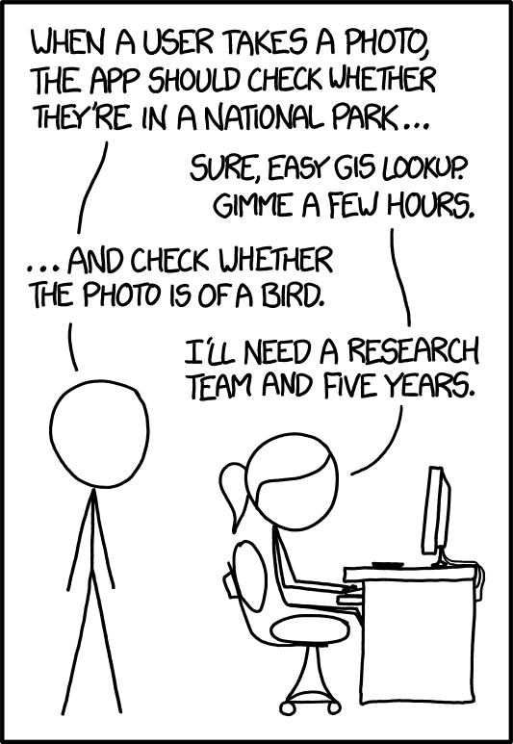

Slide 3

Overview
10’ Intro to neural networks & SGD
30’ Computer vision tutorial
10’ What our image recognizer learned
10’ Going beyond image classification

Slide 4
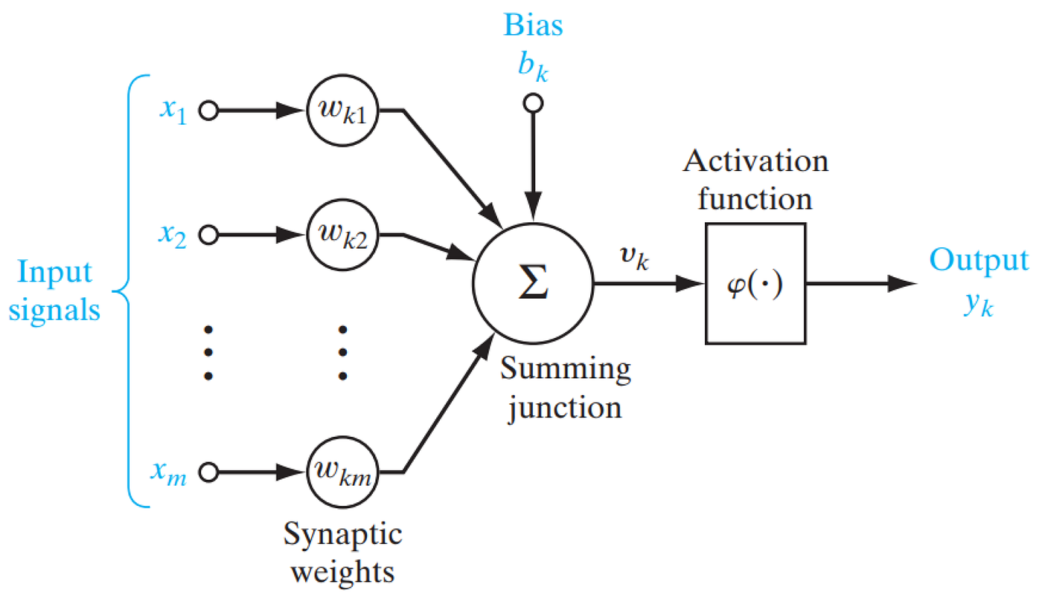
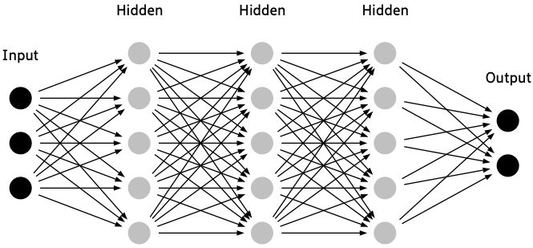
What are neural networks?
Flexible mathematical functions whose behavior is determined by their weights.
Inputs are data like images, with weights determining the network's behavior.
Results are the output produced by the network, classifications like “bird” or “forest.”
Performance is evaluated based on accuracy of predicted outcomes.

Slide 5
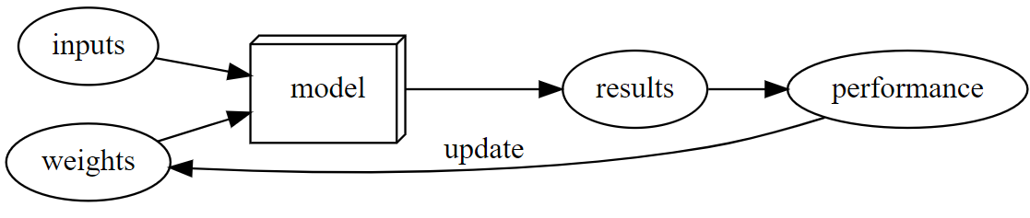
How are neural networks trained?
Training neural networks involves finding optimal weight assignments through processes like stochastic gradient descent (SGD).
SGD provides a general method for updating weights.
The training loop involves feeding inputs to the model, evaluating its performance, and updating weights accordingly.

Slide 6
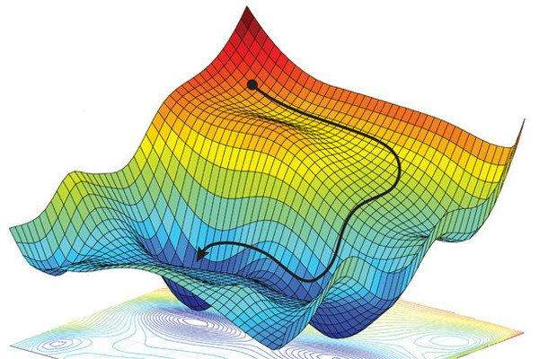
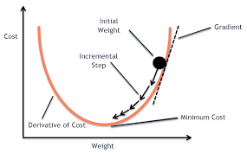
What is stochastic gradient descent, really?
Essential optimization algorithm for ML model training.
Updates model parameters iteratively to minimize loss.
Adjusts parameters in direction reducing loss.
Learning rate crucial for convergence and stability.
Computes gradients using random mini-batches, making it efficient for large datasets.

Slide 7
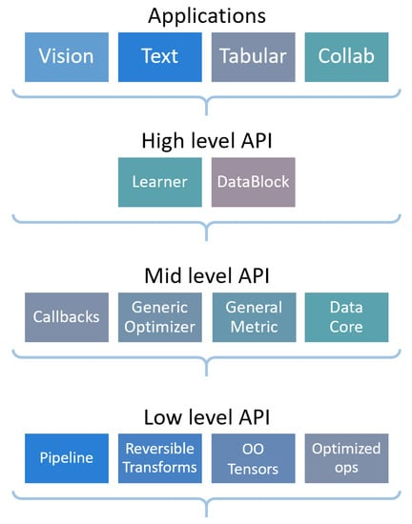
About FastAI
Deep learning library with high level API for beginners and low level API for advanced users
Based on PyTorch
Free course “Practical Deep Learning for Coders” teaches FastAI

Slide 8
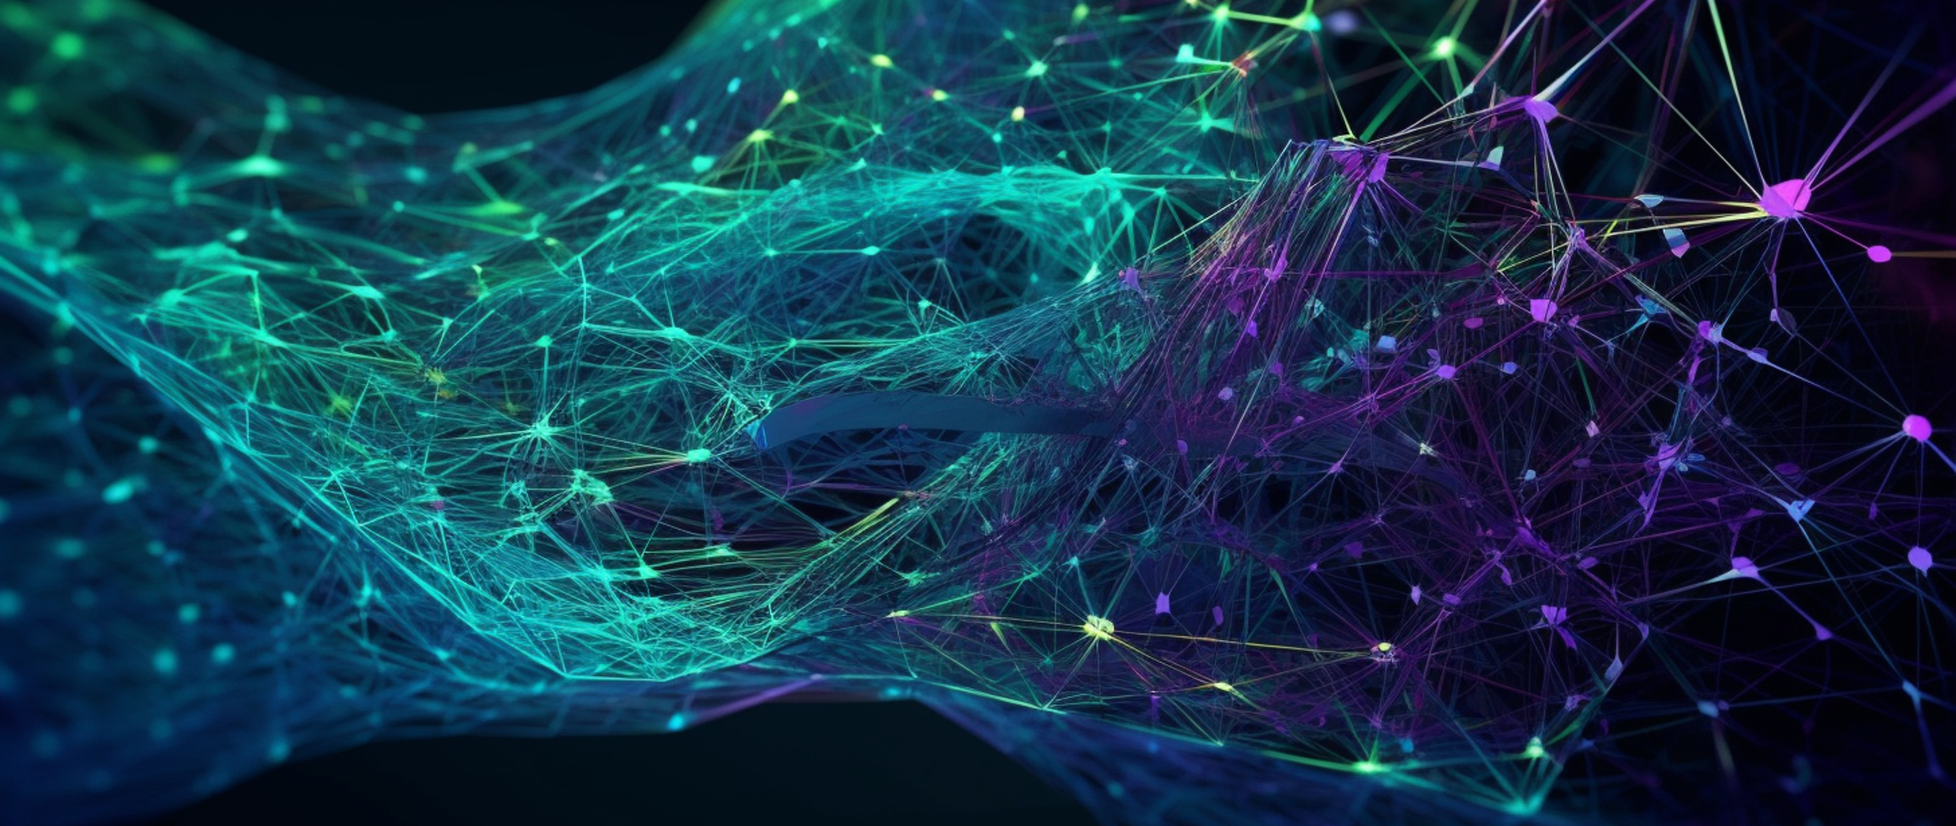
Time for an image classifier tutorial! https://github.com/MaartenKnaepen/Intro-to-computer-vision

Slide 9
What did our image recognizer learn?
Deep learning models often appear as "black box" models.
Research exists on how to interpret and understand them.
Visualizing neural network weights provides insights into model behavior.
Let’s dive into the various layers of our model!

Slide 10
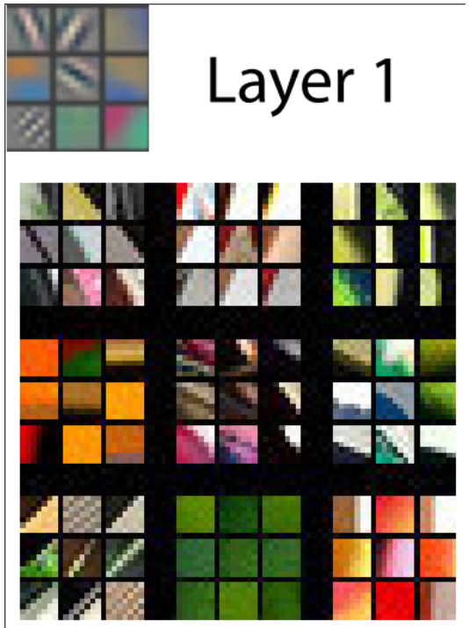
What our image recognizer learned – Layer 1
In the first layer, the model detects diagonal, horizontal, and vertical edges, along with various gradients.
These learned features serve as basic building blocks for computer vision tasks and resemble human visual perception and handcrafted computer vision features.

Slide 11
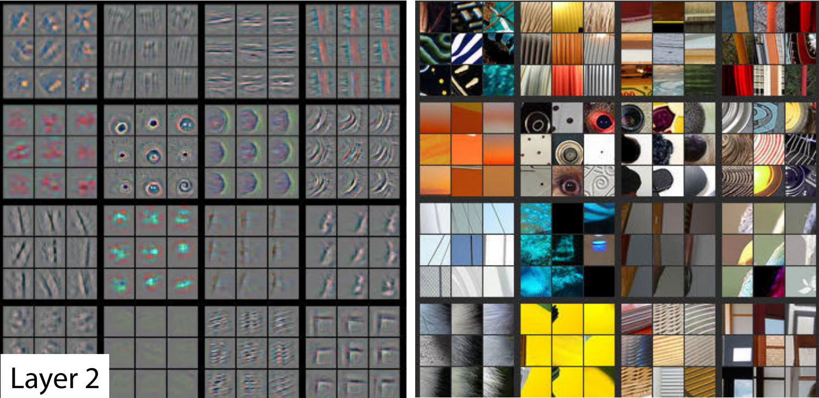
What our image recognizer learned – Layer 2
This layers detects corners, lines, circles, and patterns, built from layer 1 building blocks.
Corresponding patches from actual images illustrate feature matches, like gradients and textures from sunsets.

Slide 12
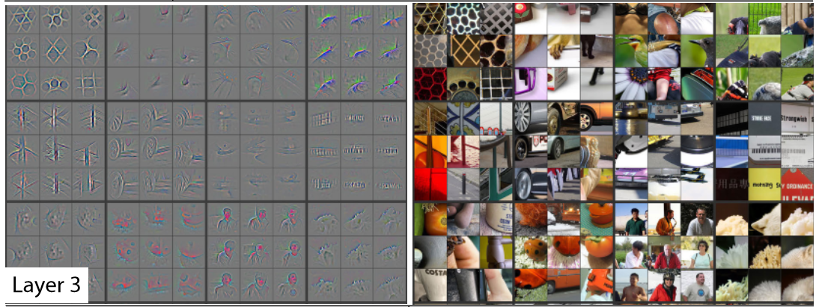
What our image recognizer learned – Layer 3
Righthand side of the picture: Features identify higher-level semantic components like car wheels, text, and flower petals.

Slide 13
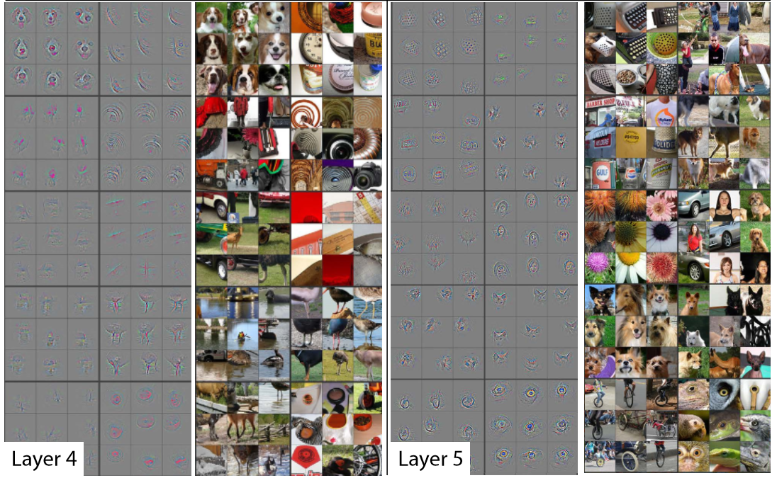
What our image recognizer learned – Layers 4-5
These layers recognize higher-level concepts.

Slide 14
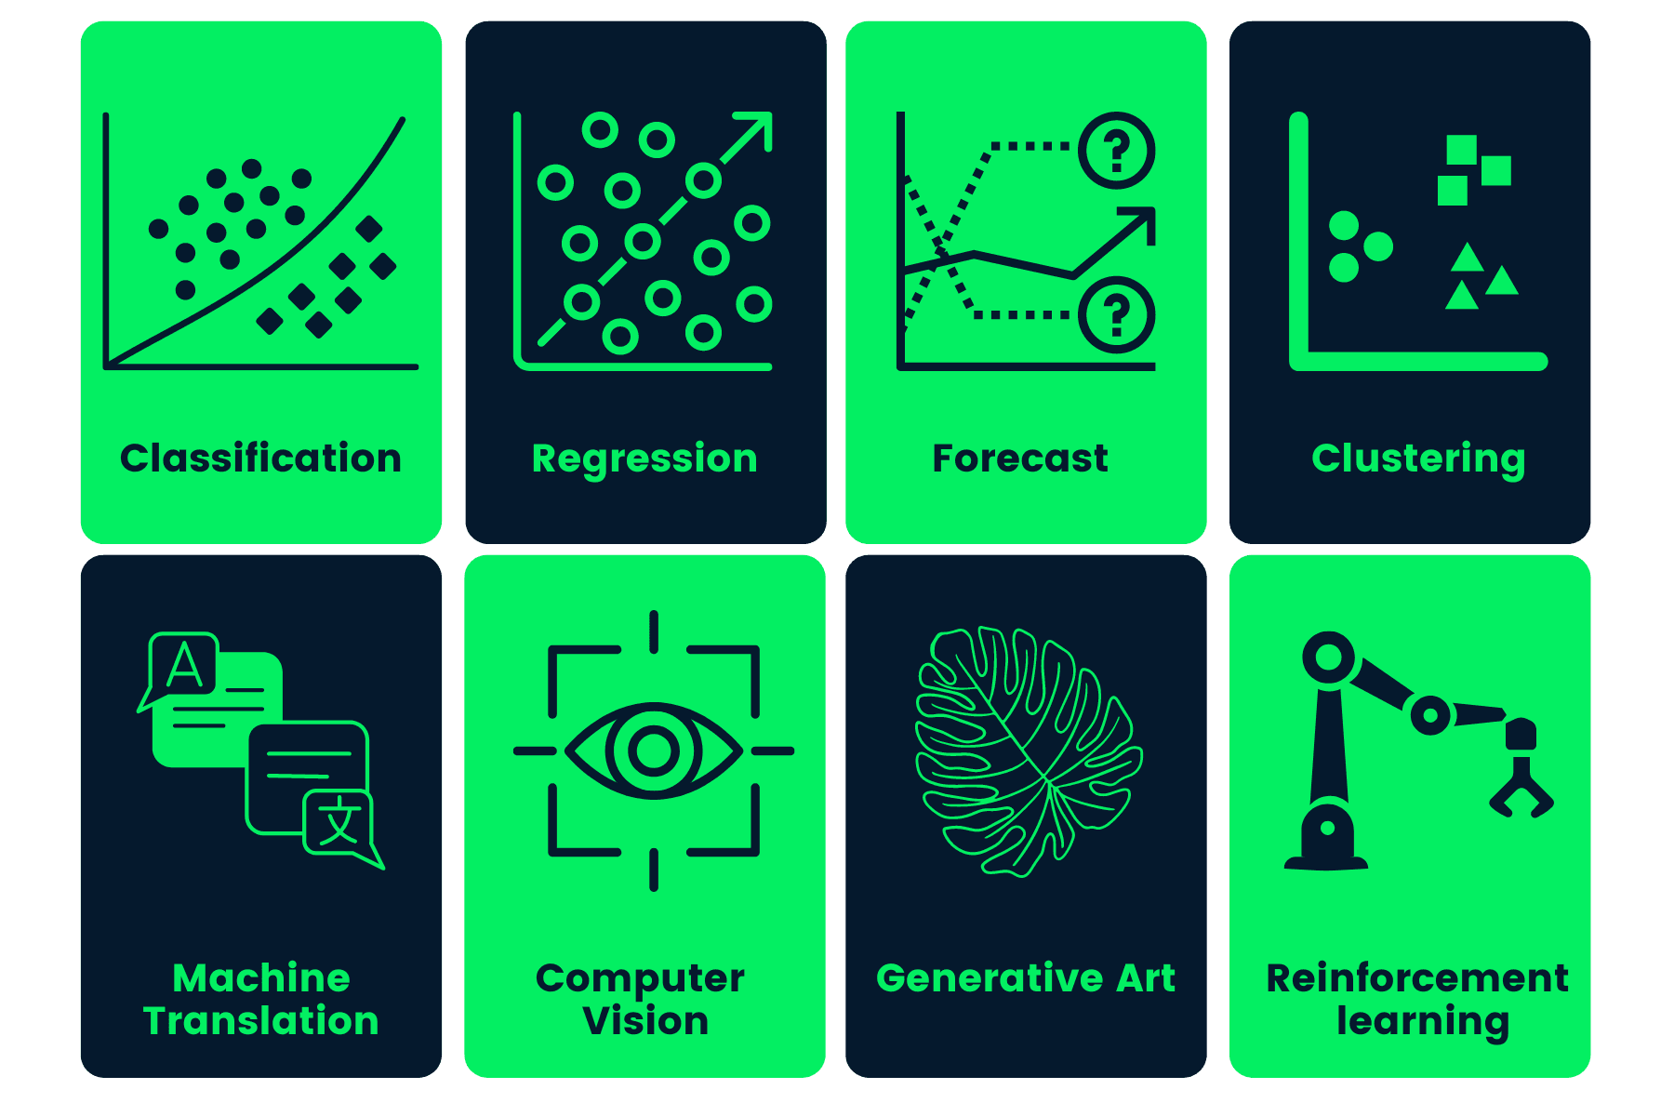
Going beyond image classification

Slide 15
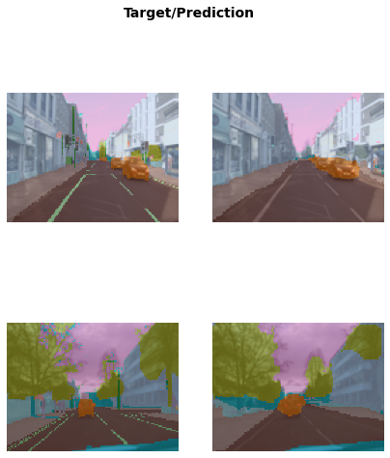
Deep learning for more than image classification
Object localization (e.g. autonomous vehicles).
Segmentation models identify objects in images with precision.
These models achieve accurate pixel-level classification, effectively delineating objects such as cars and trees.

Slide 16
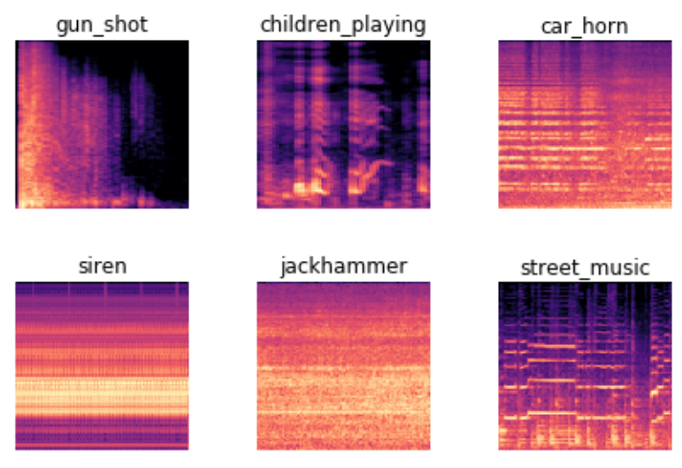
Image recognizers can handle non-image tasks
Sound can be converted into spectrograms for analysis by image recognition models.
Spectrograms display unique patterns for different sounds, aiding in accurate classification.

Slide 17
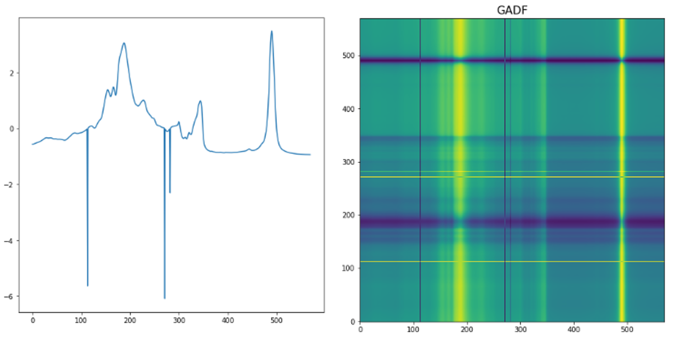
Image recognizers can handle non-image tasks
Time series can be plotted as images to emphasize key components like seasonality and anomalies.
Usage of GADF to convert time series data into images for olive oil classification with image models.

Slide 18
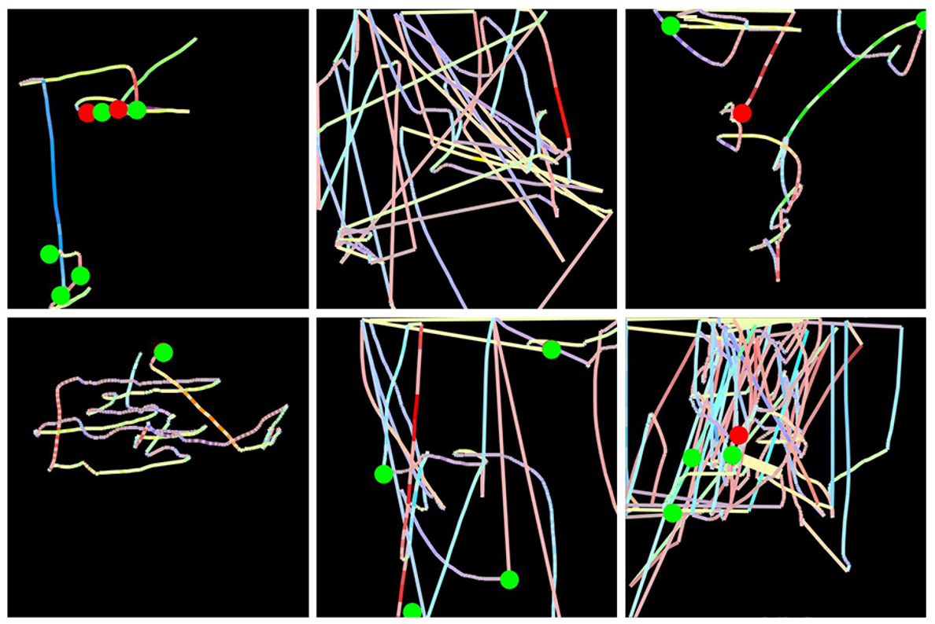
Image recognizers can handle non-image tasks
Mouse movement and click data were utilized for fraud detection at Splunk.
The data was transformed into images displaying mouse pointer details and clicks using colored lines and circles.
Analysis with an image recognition model led to a successful fraud detection approach, resulting in a patent.

Slide 19
Questions?

